Slide 1
Information Retrieval
Characteristics of the Web

Slide 2
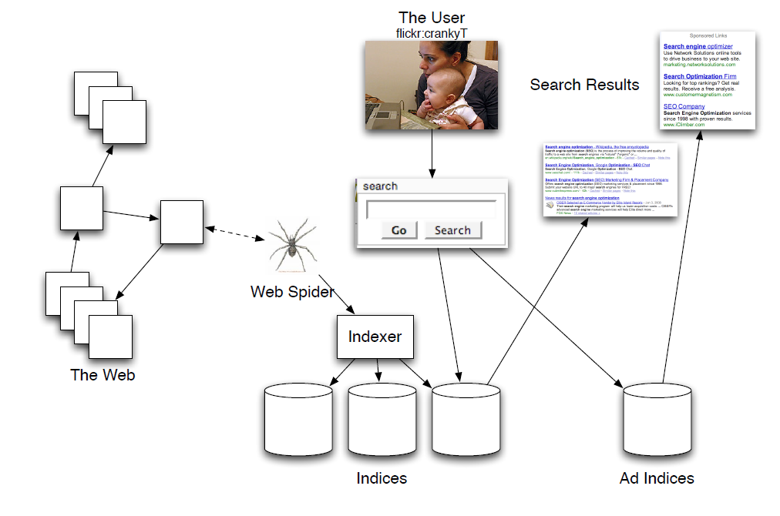
Architecture of a Web Search Engine

Slide 3
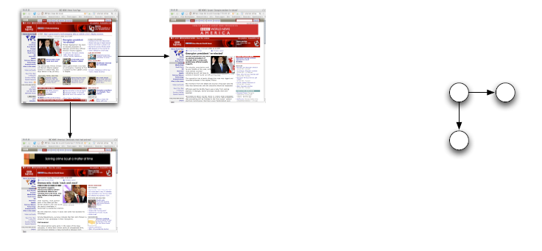
The Web Graph
The Web is a graph
Pages are nodes
Hyperlinks are directed edges

Slide 4
Classic IR Assumptions
Corpus: fixed document collection
Goal: retrieve information content relevant to the information need

Slide 5
Class IR Goal
“Relevance”
For each query Q, and stored document D, there exists a relevance score R(Q, D)
Maximize R(Q, D)
Context is ignored
User is ignored
Corpus is static

Slide 6
Web IR
The Web is huge
The Web changes all the time
There is information to avoid (adversarial IR)
One interface for hugely divergent needs

Slide 7
Characteristics
Significant duplication
30%-40% in some studies [Brod97, Shiv99]
www.copyscape.com
High linkage
More than 8 links per page
Spam, misleading and false information
Billions of pages of it
Very large
Hosts O(billion)
Pages O(???)

Slide 8
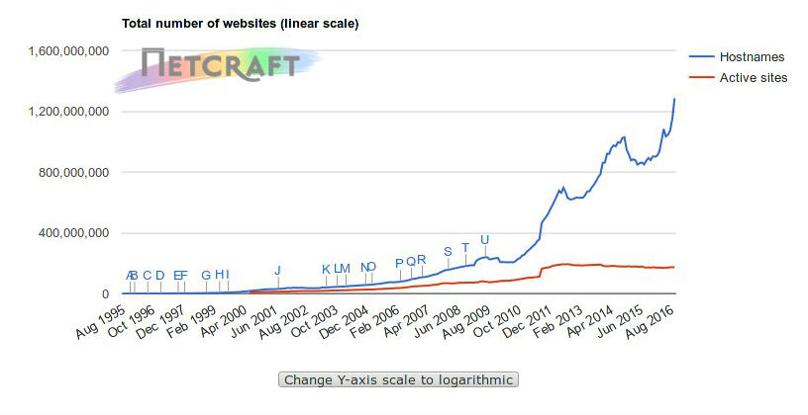
Size of the Web
https://news.netcraft.com/archives/2016/09/19/september-2016-web-server-survey.html

Slide 9
Characteristics
High rate of change
[Cho00] 720k pages from 270 popular sites sample daily for 5 months in 1999
40% changed weekly, 23% daily
[Fett02] 151M pages checked over a few months
Significant changes: 7% weekly
Some changes: 25% weekly
[Ntul04] 154 large sites recrawled from scratch weekly
8% had new pages every week
8% die
5% new content
25% new links

Slide 10
Web Evolution
Static documents
Dynamically-generated pages
Often contain ? but not always
Assembled on demand
Mostly ignored by web spiders
Too much to index
Spider traps
User-generated content (Web 2.0)
JavaScript and single-page Web applications
Mobile: HTTP without Web browsers

Slide 11
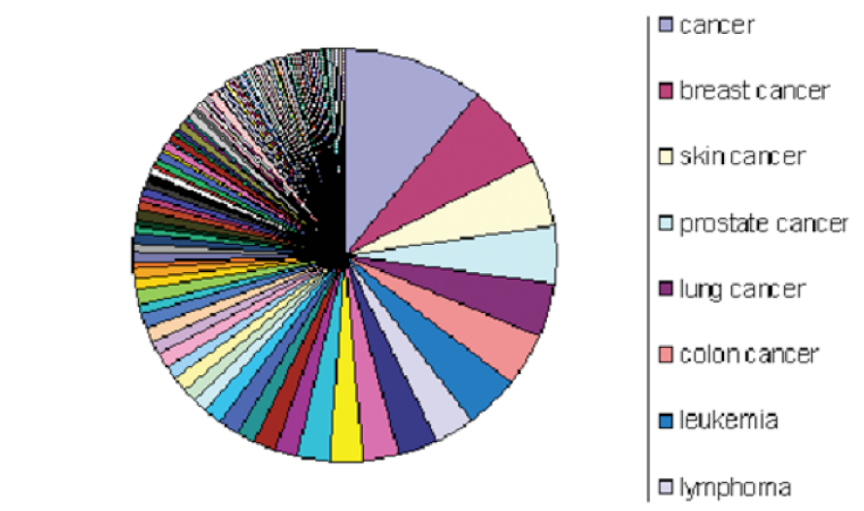
Web searches
Few popular broad queries
Many rare specific queries

Slide 12
Popular Searches
https://www.google.com/trends/
Google auto-complete

Slide 13
Web Users
[Jansen et al. 2008]
Informational needs (~80%)
Want to learn about something
Navigational needs (~10%)
Want to go to that page
Transactional needs (~10%)
Want to do something
Miscellaneous
Exploration, social, etc

Slide 14
Web Users
Ill-defined queries
Short (80% < 3 words)
Imprecise terms
No logical operators
Low effort (spelling mistakes)

Slide 15
Web Users
Wide variance in
Needs
Expectations
Knowledge
Bandwidth
Behavior
85% look over one result screen only
78% of queries are not modified
Follow links (“The scent of information”)

Slide 16
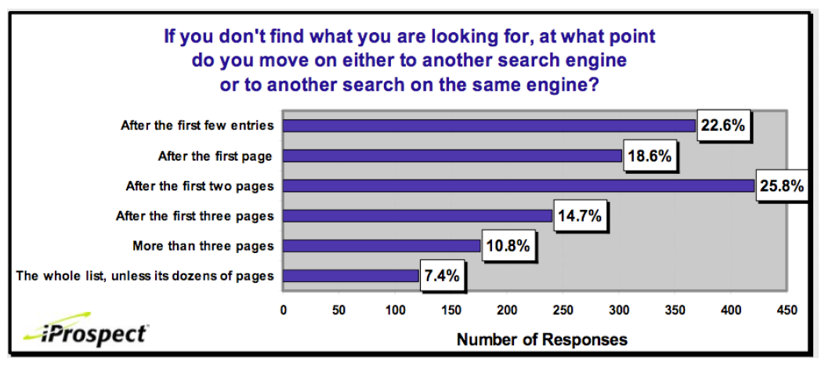
How far do people look for results?

Slide 17
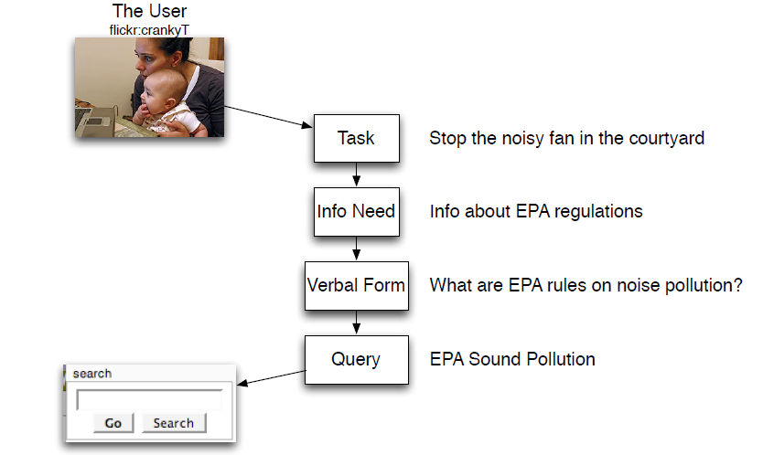
Information need pipeline

Slide 18
Answering the need behind the query
Query is often imprecise indicator of what the user wants
What can we do to improve this?
User context: who, where, what
Guess the type of information (image, map, Math, etc.)
Correct queries
(show live examples)

Slide 19
Query shortcuts
Map: Irvine, CA
Calculation: 5+4
Flight info: AA 715, LAX to LIS
Stock price: msft
Unit conversion: 1 dollar in euro
Music: This is not America

Slide 20
How do users evaluate search enignes?
Quality of pages
Classic IR relevance
Also important:
Trust
Duplicate elimination
Readability
Fast access
No pop-ups

Slide 21
How do users evaluate search enignes?
Precision is more important than recall
Precision: How relevant are the first few hits?
Recall: How many relevant hits are presented?
When is recall important?

Slide 22
How do users evaluate search enignes?
Good UI: simple, no clutter
Pre and post processing tools
Spell check / auto correct
Suggested alternative searches
Links to resources (maps, images, etc)
Able to deal with syntactic cues (ex: URL typed in search box, Math equation, etc.)

Slide 23
Advertising on Web Search

Slide 24
Ads on Search
Early synergy between search and ads
First: keyword-based engines
Altavista (1995-1997), Excite, InfoSeek, Inktomi
Paid placement ranking
Ads based on auction for keyword
Goto.com => Overture.com => Yahoo! => Google

Slide 25
Ads on Search
Link-based ranking pioneered by Google (1998+)
Links added the idea of authoritativeness to relevance
Blew away keyword-only engines
Great user experience, looking for business model
Meanwhile, Goto/Overture’s annual revenues near $1B

Slide 26
Ads on Search
Google added paid placement ads on site
Differentiated from search results
Yahoo! build a similar engine
Bought Overture for paid placement
Bought Inktomi for search
Google licensed paid placement tech from Yahoo!
Google’s current ad placement engine

Slide 27
Ads on Search
Google and most other search engines maintain that ads do not affect vendors’ ranking in search
Ad placement:
Fully automated
Balance auction price and relevance
Targeted advertising

Slide 28
Paying for Ads on the Web
Cost Per Mil (CPM)
Cost for showing the ad with 1000 page shows
Important for branding campaigns
Cost Per Click (CPC)
Cost for users clicking on the ad
Important for sales campaings

Slide 29
Warning: Click Fraud
Google has sophisticated tools to detect this

